Slide 1
Course – DBMS
Course Instructor
Dr. K. SUBRAHMANYAM,professor
Department of CSE, KL University
CSE, KL University

Slide 2
Topics Covered in Todays Class
Unit 1:
- Characteristics of the Database Approach
- Advantages of Using the Database Approach
- When not to use a DBMS
CSE, KL University

Slide 3
Main Characteristics of the Database Approach
Self-describing nature of a database system.
Insulation between programs and data, and data manipulation.
Support of multiple views of the data.
Sharing of data and multi-user transaction processing
CSE, KL University

Slide 4
Main Characteristics of the Database Approach
Self-describing nature of a database system
What will be your description of the data stored in the following tables ?
1BM14CS001 | Aditya | 3 | WP
1BM14CS002 | Bharath | 3 | DS
1BM14CS001 | 1000
1BM14CS002 | 1000
1BM14CS001 | S
1BM14CS002 | B
CSE, KL University

Slide 5
Main Characteristics of the Database Approach
Self-describing nature of a database system.
Student_Details
USN | Name | Sem | Sub
1BM14CS001 | Aditya | 3 | WP
1BM14CS002 | Bharath | 3 | DS
Student_ExamFee_Details
Student_Grade_Details
USN | Amount
1BM14CS001 | 1000
1BM14CS002 | 1000
USN | Grade
1BM14CS001 | S
1BM14CS002 | B
CSE, KL University

Slide 6
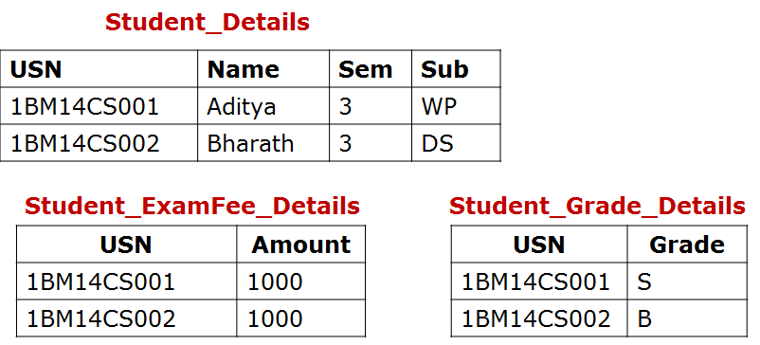
Main Characteristics of the Database Approach
Self-describing nature of a database system.
Column_name | Data_Type | Belongs_to
USN | Char(10) | Student_Details
Name | Char(30) | Student_Details
Sem | Integer | Student_Details
Sub | Char(2) | Student_Details
Amount | Float | Student_ExamFee_Details
Grade | Char(1) | Student_Grade_Details
Catalog
Information stored in
catalog is called
meta-data which
Describes the structure
Of primary
database
CSE, KL University

Slide 7
Main Characteristics of the Database Approach
2. Insulation between programs and data, and data manipulation.
File Approach
student.txt
1BM14CS001 Aditya LA,Java,DBMS,OS,DC
1BM14CS002 Baharth DBMS,OS,DC
fp=fopen("student.txt","r");
while(fscanf(fp,"%s %s %s",USN,name,subjects)!=EOF)
{
printf("USN: %s Name: %s Subjects: %s",USN,name,subjects);
}
What will be the Output of the above program statements ?
CSE, KL University

Slide 8
Main Characteristics of the Database Approach
2. Insulation between programs and data, and data manipulation.
File Approach
student.txt
Aditya 1BM14CS001 LA,Java,DBMS,OS,DC
Baharth 1BM14CS002 DBMS,OS,DC
fp=fopen("student.txt","r");
while(fscanf(fp,"%s %s %s",USN,name,subjects)!=EOF)
{
printf("USN: %s Name: %s Subjects: %s",USN,name,subjects);
}
What will be the Output of the above program statements ?
CSE, KL University

Slide 9
Main Characteristics of the Database Approach
2. Insulation between programs and data, and data manipulation.
DBMS Approach
student
USN | Name | Subjects
1BM14CS001 | Aditya | LA, Java, DBMS,OS,DC
1BM14CS002 | Bharath | DBMS, OS, DC
select USN, Name, Subjects from student;
SQL query to retrieve
and display table
information
1BM14CS001 Aditya LA,Java,DBMS,OS,DC
1BM14CS002 Bharath DBMS,OS,DC
CSE, KL University

Slide 10
Main Characteristics of the Database Approach
2. Insulation between programs and data, and data manipulation.
DBMS Approach
student
Name | USN | Subjects
Aditya | 1BM14CS001 | LA, Java, DBMS,OS,DC
Bharath | 1BM14CS002 | DBMS, OS, DC
select USN, Name, Subjects from student;
SQL query to retrieve
and display table information
1BM14CS001 Aditya LA,Java,DBMS,OS,DC
1BM14CS002 Bharath DBMS,OS,DC
CSE, KL University

Slide 11
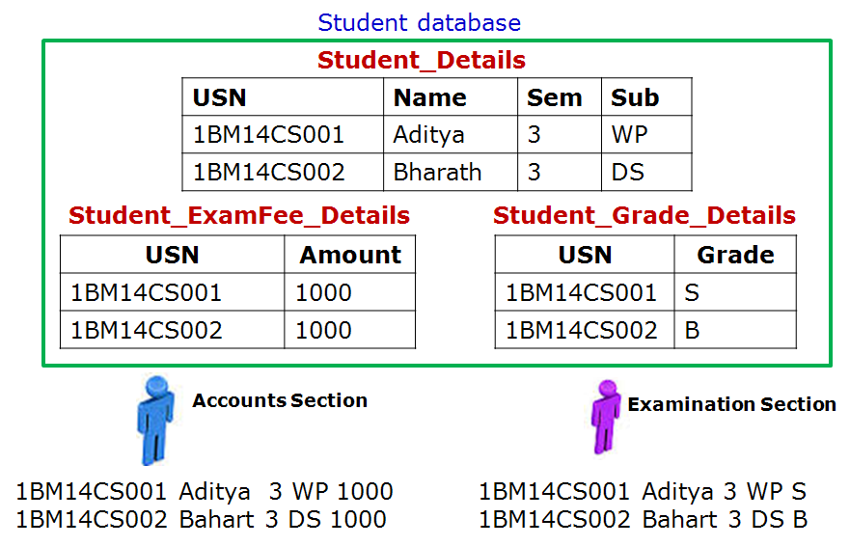
Main Characteristics of the Database Approach
3. Support of multiple views of the data
CSE, KL University

Slide 12
Main Characteristics of the Database Approach
4. Sharing of data and multi-user transaction processing
Train Reservation Database
Source | Destination | Train Name | Start Time | Start Date | Number of Seats Availability
Bangalore | Mysore | Chamundi Express | 18:15 | 14-1-2016 | 2
Train Ticket Booking Software
CSE, KL University

Slide 13
Main Characteristics of the Database Approach
Self-describing nature of a database system:
  A DBMS catalog stores the description of a particular database (e.g. data structures, types, and constraints)
  The description is called meta-data.
  This allows the DBMS software to work with different database applications.
Insulation between programs and data, and data manipulation:
  Called program-data independence.
  Allows changing data structures and storage organization without having to change the DBMS access programs.
  A data model is used to hide storage details and present the users with a conceptual view of the database.
  Programs refer to the data model constructs rather than data storage details
CSE, KL University

Slide 14
Main Characteristics of the Database Approach
Support of multiple views of the data:
  Each user may see a different view of the database, which describes only the data of interest to that user.
Sharing of data and multi-user transaction processing:
  Allowing a set of concurrent users to retrieve from and to update the database.
  Concurrency control within the DBMS guarantees that each transaction is correctly executed or aborted
  Recovery subsystem ensures each completed transaction has its effect permanently recorded in the database
  OLTP (Online Transaction Processing) is a major part of database applications. This allows hundreds of concurrent transactions to execute per second.
CSE, KL University

Slide 15
Advantages of Using the Database Approach
Controlling redundancy in data storage and in development and maintenance efforts.
Restricting unauthorized access to data.
Providing persistent storage for program Objects (data structures provided by DBMS & the programming languages were incompatible)
Providing Storage Structures (e.g. indexes) for efficient Query Processing
Providing backup and recovery services.
Providing multiple interfaces to different classes of users.
Representing complex relationships among data.
Enforcing integrity constraints on the database.
Drawing inferences and actions from the stored data using deductive and active rules
CSE, KL University

Slide 16
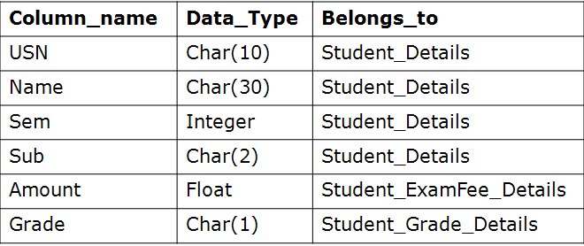
Understanding integrity constraints on the database
Database Catalog for following database tables
Which of the following tables data storage is correct as
per the above catalog definition ?
Student_Grade_Details
Student_Grade_Details
USN | Grade
1BM14CS001 | S
1BM14CS002 | B
USN | Grade
1BM14CS001 | S
1BM14CS002 | 8
CSE, KL University

Slide 17
Understanding integrity constraints on the database
Student_Details
USN | Name | Sem | Sub
1BM14CS001 | Aditya | 3 | WP
1BM14CS002 | Bharath | 3 | DS
What is wrong in the following table data as per the Student_Details table ?
Student_Grade_Details
USN | Grade
1BM14CS001 | S
1BM14CS002 | B
1BM14CS003 | C
CSE, KL University

Slide 18
Understanding drawing of “inferences and actions” from the stored data
Student_Grade_Details
USN | Grade
1BM14CS001 | S
1BM14CS002 | B
1BM14CS003 | C
1BM14CS004 | S
1BM14CS005 | F
1BM14CS006 | S
Using the above table data, Can you infer
How many Students have scored S grade and What are their USN’s?
CSE, KL University

Slide 19
Understanding drawing of “inferences and actions” from the stored data
Student_Grade_Details
Catalog
USN | Grade
1BM14CS001 | S
1BM14CS002 | B
1BM14CS003 | C
1BM14CS004 | S
1BM14CS005 | F
1BM14CS006 | S
Column_name | Data_Type | Constraint
USN | Char(10)
Grade | Char(1) | Should not be empty
Using the above Catalog information, Can you tell
Whether the following insert action on Student_Grade_Details table is Right or Wrong ?
insert into Student_Grade_Details values (1BM14CS007);
CSE, KL University

Slide 20
When not to use a DBMS ?
CSE, KL University

Slide 21
When not to use a DBMS
Main inhibitors (costs) of using a DBMS:
  High initial investment and possible need for additional hardware.
  Overhead for providing generality, security, concurrency control, recovery, and integrity functions.
When a DBMS may be unnecessary:
  If the database and applications are simple, well defined, and not expected to change.
  If access to data by multiple users is not required.
CSE, KL University

Slide 22
Activity - Questionnaire
What are the four main Characteristics of DBMS ?
What is the meaning of “Catalog” w.r.t DBMS ?
CSE, KL University

Slide 23
Topics Covered in Todays Class
Unit 1: Database System Concepts and Architecture
Data Models, Schemas and instances
Three Schema Architecture and Data Independence
Database language and interfaces
The Database System Environment
CSE, KL University

Slide 24
Case Study 1
For example Say Ramu, who is staying in Thadepalli area has a empty land plot of 30x40 feet area. He wants to construct a house in this site. He is going to discuss this issue with you. But you are computer science student. How you will guide Ramu to resolve his issue.
CSE, KL University

Slide 25
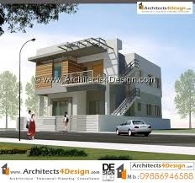
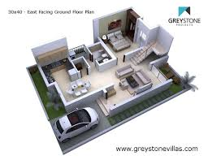
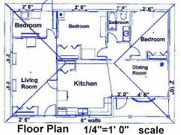
Case Study 1
Low
High level view of house
Building Architecture
Quantity of cement, brick, mud, iron, wood….etc to be used.
Middle level view
Civil Engineer
Low level view
Building Constructor
CSE, KL University

Slide 26
Case Study 2
Principal
KL College of Engineering
Dear Student,
I need an software application to keep track of student Information and Department information. You should build a software which will help me to carry out the operations, such as
display, insertion, deletion and updating of Student and department information. For each Student USN, Name, Semester and Department name to be stored. For each Department its name and HOD name to be stored. Provide your design plan for developing this application software.
CSE, KL University

Slide 27
Objective of todays class
Understanding the basic terminologies and definitions involved in building Architecture of Database Systems.
In this regard, First we will understand
Data Models, Schemas and Instances
CSE, KL University

Slide 28
Data Models
Data Abstraction generally refers to the suppression of details of data organization and storage and the highlighting of the essential features for improved understanding of data.
Data Model:
  A set of concepts to describe the structure of a database, the operations for manipulating these structures, and certain constraints that the database should obey.
  Data Models provides the necessary means to achieve data abstraction.
CSE, KL University

Slide 29
Categories of Data Models
Conceptual (high-level, semantic) data models:
  Provide concepts that are close to the way many users perceive data.
    (Also called entity-based or object-based data models.)
Implementation (representational) data models:
  Provide concepts that fall in between high and low level, used by many commercial DBMS implementations (e.g. relational data models used in many commercial systems).
Physical (low-level, internal) data models:
  Provide concepts that describe details of how data is stored in the computer. These are usually specified in an ad-hoc manner through DBMS design and administration manuals
CSE, KL University

Slide 30
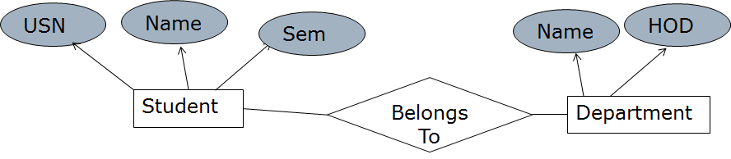
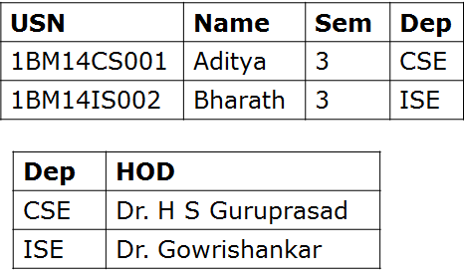
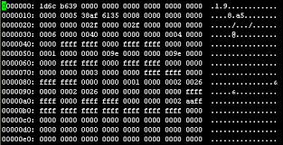
Categories of Data Models
Conceptual (high-level)
Implementation (Representational)
Physical (low-level)
CSE, KL University

Slide 31
Schemas, Instance and Database State
Database Schema:
  The description of a database.
  Includes descriptions of the database structure, data types, and the constraints on the database.
  Schema Diagram:
  An illustrative display of (most aspects of) a database schema
Database State:
  The actual data stored in a database at a particular moment in time. This includes the collection of all the data in the database.
  Also called database instance (or occurrence or snapshot).
    The term instance is also applied to individual database components, e.g. record instance, table instance, entity instance
CSE, KL University

Slide 32
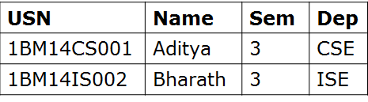
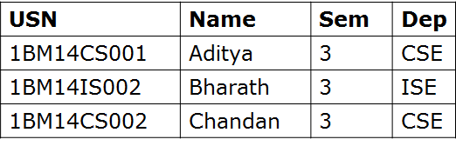
Schemas, Instance and Database State
Schema Diagram
Department
Student
USN | Name | Sem | Dep
Dep | HOD
Database State at time “X”
Database State at time “Y”
Database Instance
Database Instance
CSE, KL University

Slide 33
Three-Schema Architecture
Defines DBMS schemas at three levels:
  Internal schema at the internal level to describe physical storage structures and access paths (e.g indexes).
    Typically uses a physical data model.
  Conceptual schema at the conceptual level to describe the structure and constraints for the whole database for a community of users.
    Uses a conceptual or an implementation data model.
  External schemas at the external level to describe the various user views.
    Usually uses the same data model as the conceptual schema.
CSE, KL University

Slide 34
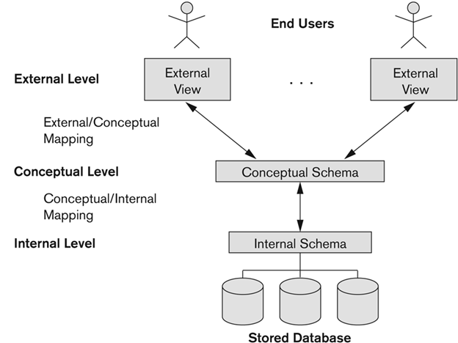
The three-schema architecture
CSE, KL University

Slide 35
Data Independence
Logical Data Independence:
  The capacity to change the conceptual schema without having to change the external schemas and their associated application programs.
Physical Data Independence:
  The capacity to change the internal schema without having to change the conceptual schema.
CSE, KL University

Slide 36
Review on Your Own
Database language and interfaces
The Database System Environment
CSE, KL University

Slide 37
Data Definition language and Interfaces
DBMS Languages
  Data Definition Language (DDL)
  Storage Definition Language (SDL)
  View Definition language (VDL)
  Data manipulation Language (DML)
Data Interfaces
  Menu-based
  Form-Based
  Graphical User Interface
  Natural language Interface
  Speech Input and Output
  Interfaces for Parametric users
  Interfaces for DBA
CSE, KL University

Slide 38
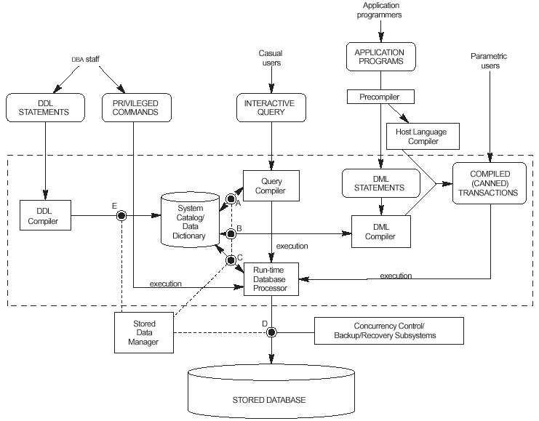
The Database System Environment
CSE, KL University

Slide 39
Activity - Questionnaire
1. Mention three different levels in Three-Schema Architecture
CSE, KL University

Slide 40
Thanks for Listening
Summary
CSE, KL University

Slide 41
Student database
Student_Details
USN | Name | Sem | Sub
1BM14CS001 | Aditya | 3 | WP
1BM14CS002 | Bharath | 3 | DS
Student_ExamFee_Details
Student_Grade_Details
USN | Amount
1BM14CS001 | 1000
1BM14CS002 | 1000
USN | Grade
1BM14CS001 | S
1BM14CS002 | B
Accounts Section
Examination Section
1BM14CS001 Aditya 3 WP 1000
1BM14CS002 Bahart 3 DS 1000
1BM14CS001 Aditya 3 WP S
1BM14CS002 Bahart 3 DS B
CSE, KL University

Slide 42
Categories of Data Models
USN
Name
Sem
Name
HOD
Belongs To
Student
Department
USN | Name | Sem | Dep
1BM14CS001 | Aditya | 3 | CSE
1BM14IS002 | Bharath | 3 | ISE
Dep | HOD
CSE | Dr. H S Guruprasad
ISE | Dr. Gowrishankar
CSE, KL University

Slide 43
USN | Name | Sem | Dep
1BM14CS001 | Aditya | 3 | CSE
1BM14IS002 | Bharath | 3 | ISE
1BM14CS002 | Chandan | 3 | CSE
CSE, KL University

